Slide 1
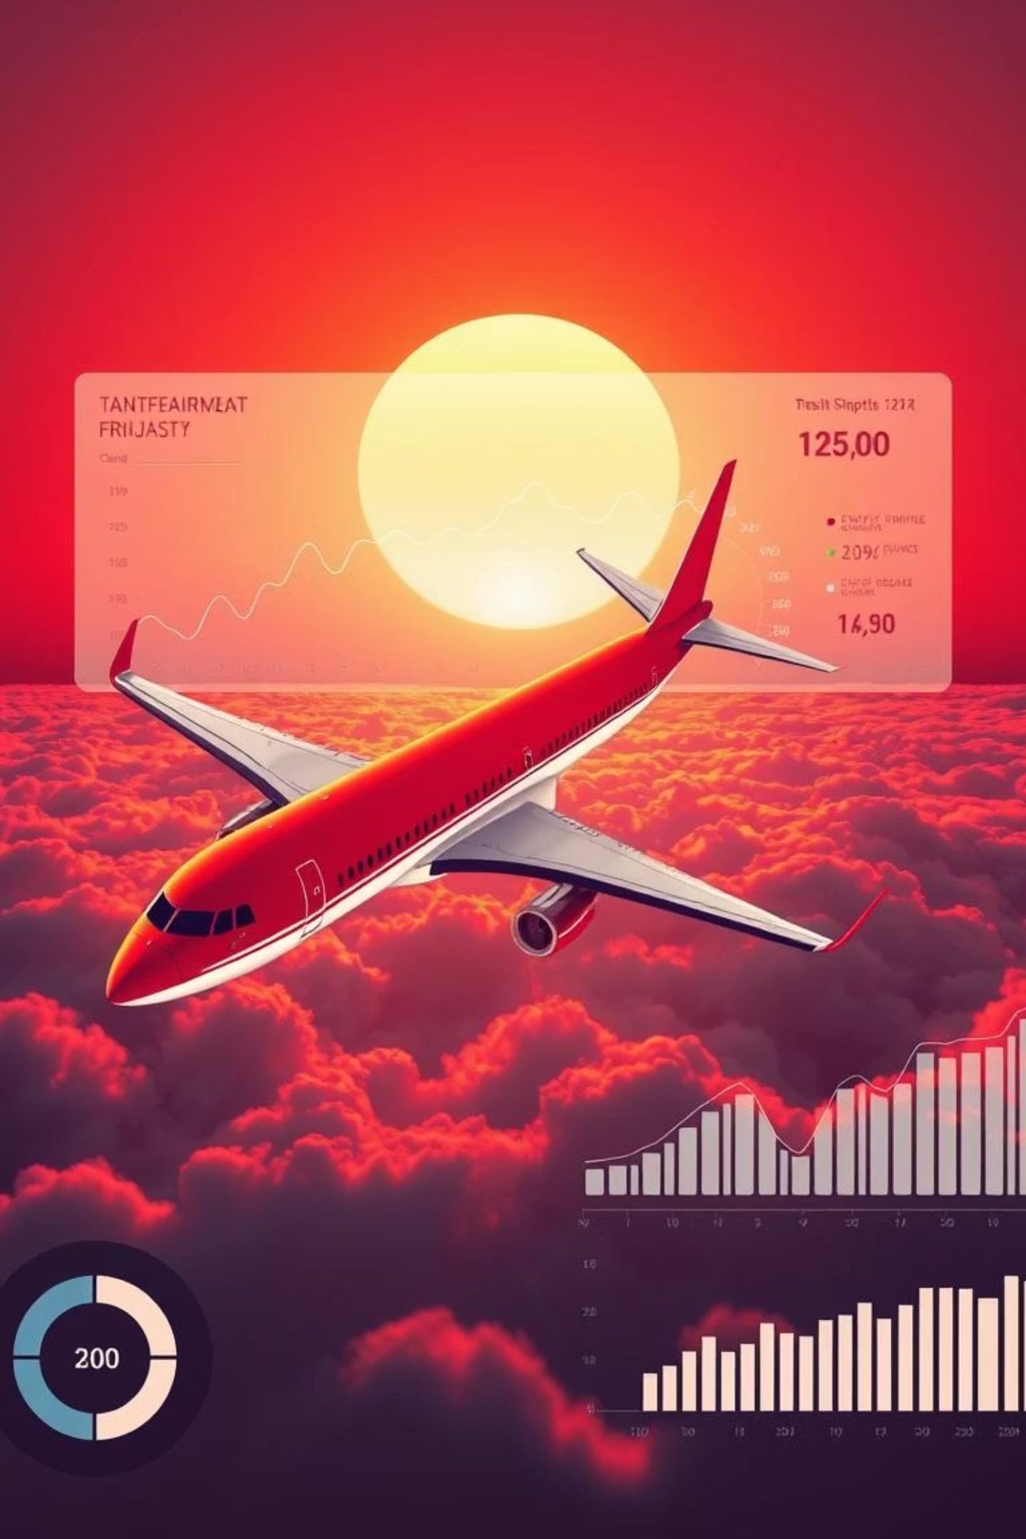
Airlines Data Analysis
Welcome to our in-depth analysis of airline operational data. This presentation aims to dissect key performance indicators, identify areas for optimization, and propose data-driven solutions to enhance profitability and navigate current industry challenges. We will explore fleet utilization, revenue streams, and occupancy rates to unlock new growth opportunities for our valued passengers and stakeholders.

Slide 2
Business Problem: Navigating Headwinds in Air Transportation
Our company has consistently delivered high-quality air transportation services, ensuring safe, comfortable, and convenient journeys for our passengers over several years. We operate a diverse fleet, from compact business jets to medium-sized aircraft. However, the current economic and regulatory landscape presents significant challenges to our profitability. This analysis will focus on leveraging our internal database to identify opportunities for increasing occupancy rates and, consequently, boosting the average profit earned per seat.
Key Obstacles Impacting Profitability:
Stricter Environmental Regulations
Higher Flight Taxes
The aviation industry faces mounting pressure to reduce its carbon footprint, leading to more stringent environmental laws. These regulations not only escalate operating costs through compliance measures and investments in greener technologies but also impose limitations on fleet expansion and route development, hindering potential growth.
Governments globally are imposing increased taxes on air travel, primarily to address environmental concerns and generate revenue. This rise in flight taxes directly contributes to higher ticket prices, which can subsequently reduce consumer demand and impact overall passenger volume, further squeezing profit margins.
Tight Labor Market & Increased Costs
Rising Fuel Prices
The aviation sector is grappling with a severe scarcity of skilled professionals, including pilots, mechanics, and ground staff. This shortage results in elevated labor costs due to competitive wages and benefits, alongside increased employee turnover rates. High turnover necessitates continuous recruitment and training, adding further financial strain and operational inefficiencies.
Fluctuations in global oil markets have led to significant increases in aviation fuel prices, which represent a substantial portion of an airline's operating expenses. Unpredictable and sustained high fuel costs directly erode profitability and make long-term financial planning more challenging, demanding agile hedging strategies and fuel-efficient fleet management.

Slide 3
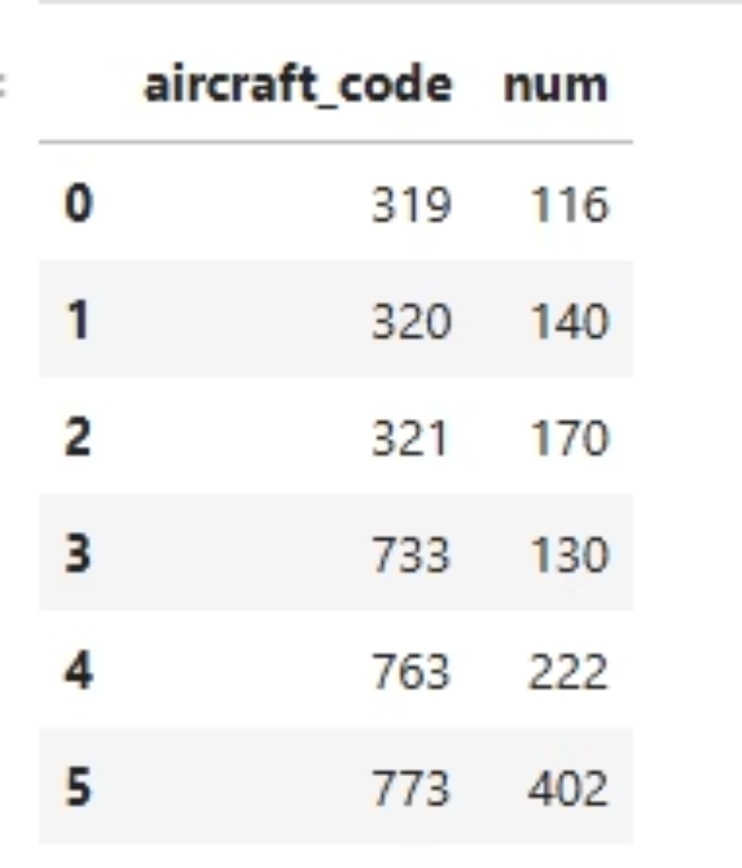
Q1) Fleet Capacity Analysis: Planes with More Than 100 Seats
Understanding our fleet's capacity is fundamental to optimizing routes, pricing, and overall profitability. This analysis focuses on aircraft with a seating capacity exceeding 100 passengers, as these larger planes are typically deployed on higher-demand routes and contribute significantly to overall revenue.
Key Findings from the Analysis:
Aircraft Identification: We have identified all aircraft types within our fleet that are configured with more than 100 seats. This classification is crucial for strategic route planning and capacity allocation.
Ticket Booking Trends: We've analyzed the historical data on the number of tickets booked over time, providing insights into demand patterns and peak travel periods for larger aircraft.
Total Revenue Over Time: A correlated analysis tracks the total revenue generated by these aircraft, allowing us to assess their financial performance and contribution to the company's top line.
Average Fare per Aircraft: We've calculated the average fare for each aircraft type, segmented by different fare conditions (e.g., economy, business, comfort). This helps in understanding revenue yield per seat and informs dynamic pricing strategies.
The attached screenshot visually represents the aircraft meeting the criteria of having more than 100 seats, along with their precise seating capacities. This visualization enables quick identification of our larger assets and serves as a foundational data point for subsequent operational and financial analyses.

Slide 4
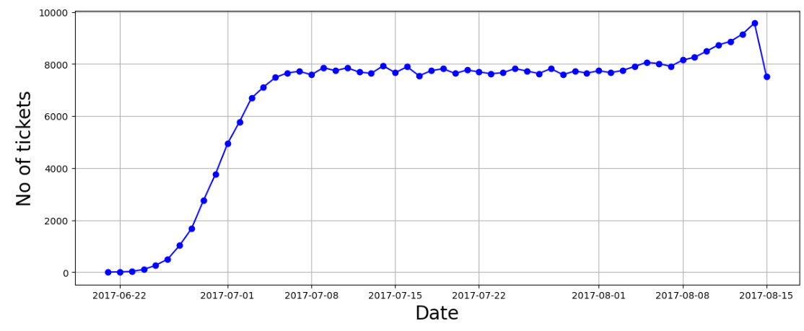
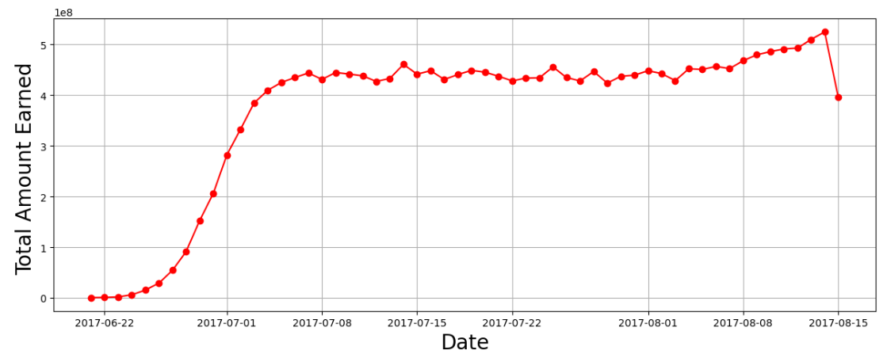

Slide 5



Q2) Revenue and Ticket Trends: A Time-Series Analysis
How the number of tickets booked and total amount earned changed with time?
To gain a comprehensive understanding of our operational performance and market dynamics, we conducted a time-series analysis on ticket booking volumes and corresponding revenue. This involved plotting both metrics over a defined period to observe trends, identify anomalies, and derive actionable insights.
Ticket Booking Trends (Blue Line)
Revenue Earned (Red Line)
Strategic Implications
Our analysis reveals a distinct pattern in ticket bookings. From July 22nd, bookings show a gradual and consistent increase up to July 7th. Following this, the volume maintains a relatively stable pattern throughout August. A significant observation is a sharp, unexplained peak in bookings on a single day, indicating an exceptional event or demand surge. Investigating the root cause of this peak is paramount.
The total revenue earned by the company closely mirrors the trajectory of ticket sales. The red line demonstrates a similar trend, confirming that revenue generation is directly proportional to booking volumes. This correlation underscores the importance of ticket sales as the primary driver of our financial performance. The peak in revenue perfectly aligns with the peak in ticket bookings.
The close correlation between ticket bookings and revenue highlights that any factor influencing booking volumes directly impacts our financial health. The identified peak in ticket sales represents a significant opportunity. Understanding the specific circumstances or strategies that led to this surge could provide a blueprint for increasing overall revenue and optimizing airline performance across the board. Further investigation into this peak is recommended to replicate its success.
Conclusion: By strategically leveraging the insights from this time-series analysis, particularly by understanding and replicating the conditions that led to the peak in ticket bookings, we can significantly enhance our company's profitability and ensure more consistent revenue growth.

Slide 6
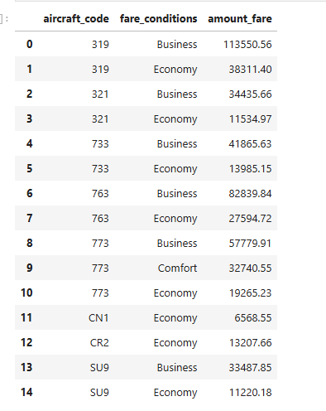
Q3) Average Charges Per Aircraft and Fare Condition
To refine our pricing strategies and optimize revenue yield, we undertook a detailed analysis of the average charges for each aircraft type, segmented by the three primary fare conditions: Business, Comfort, and Economy. This granular view allows us to understand the revenue contribution of different seating classes across our diverse fleet.
Key Results from the Bar Graph Analysis:
Fare Class Availability: Our fleet primarily offers three fare conditions: Business, Comfort, and Economy. A notable finding is that aircraft types 'CN1' and 'CR2' exclusively offer Economy class. Conversely, the '773' aircraft is unique in providing a Comfort class option, alongside Business and Economy.
Business Class Premium: Across all aircraft where Business class is available, its average charge consistently surpasses that of Economy class. This premium pricing structure reflects the enhanced services, amenities, and seating comfort offered to business class passengers, validating our tiered service model.
Consistency Across Fleet: The pricing differential between Business and Economy classes remains consistent regardless of the specific aircraft type. This indicates a standardized pricing approach across the fleet for these fare categories.
Strategic Pricing Implications: The data suggests opportunities to further analyze demand elasticity for Comfort class on the '773' aircraft, and potentially explore introducing Comfort or Business class on other aircraft types if market demand supports it and operational feasibility allows. For 'CN1' and 'CR2', strategies to maximize Economy class yield are crucial.
The bar graph vividly illustrates the average costs associated with each fare condition for every aircraft. This visual representation provides a clear and actionable overview for our revenue management team to fine-tune pricing strategies, optimize inventory, and enhance profitability across our fleet.

Slide 7
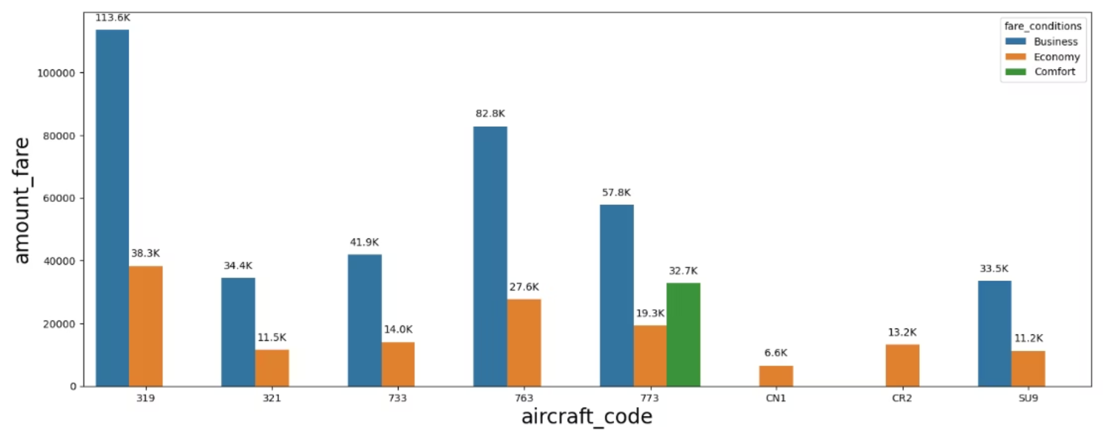
Annual Revenue and Revenue per Ticket: A Detailed Breakdown
Understanding the total annual revenue generated by each aircraft type, coupled with the average revenue per ticket, is critical for assessing fleet efficiency and profitability. This analysis provides insights into which aircraft contribute most significantly to our top line and the factors influencing their performance.
Figure 1 above provides a comprehensive visualization of the total annual revenue per aircraft and the average revenue per ticket.
Top Performer: SU9 Aircraft The SU9 aircraft emerges as the highest performer in terms of total annual revenue. Interestingly, our data suggests that the average prices for both Business and Economy classes on the SU9 are comparatively lower than on other aircraft. This competitive pricing strategy appears to be a key factor in attracting a higher volume of passengers, thereby driving increased ticket sales and overall revenue for this aircraft type. This highlights the importance of strategic pricing to stimulate demand.
Under Performer: CN1 Aircraft Conversely, the CN1 aircraft records the least total annual revenue. While it primarily offers Economy class tickets at very competitive prices, its low revenue might be attributable to a perceived lack of facilities or amenities compared to other aircraft in its category, or perhaps a lower demand on its assigned routes. Further investigation into passenger feedback and route analysis for CN1 is recommended to understand underlying reasons for its underperformance despite low fares.
Maximizing Profitability through Revenue Stream Analysis The contrasting performance of SU9 and CN1 underscores a critical insight: airlines must continuously analyze their diverse revenue streams and the factors influencing them. This includes not just ticket sales but also ancillary revenues, cargo, and premium services. Optimizing pricing, enhancing service offerings, and aligning aircraft deployment with market demand are essential strategies to maximize profitability across the entire fleet and ensure sustainable growth.

Slide 8
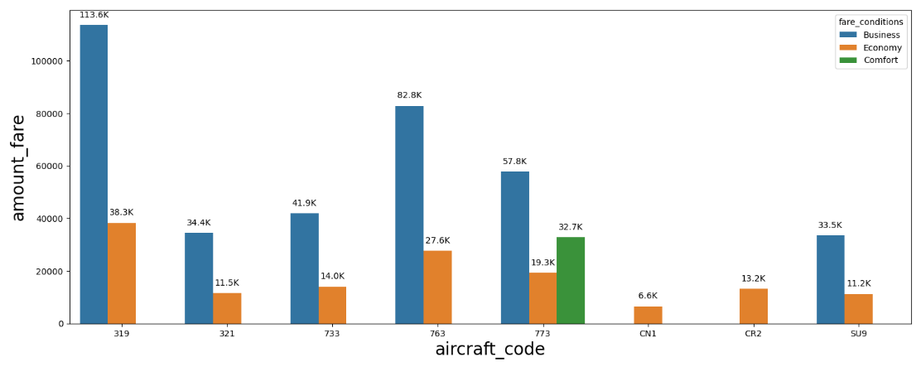

Slide 9



Q4) Total Revenue and Average Revenue Per Ticket: Deeper Dive
Continuing our financial analysis, this section elaborates on the total revenue generated annually by each aircraft and the average revenue per ticket, building upon the insights from the previous visualization.
Fleet Contribution to Total Revenue
Average Revenue Per Ticket Insights
Strategic Implications for Profitability
The analysis clearly delineates each aircraft type's contribution to the company's overall annual turnover. This allows us to identify our revenue powerhouses and those requiring strategic intervention. Factors such as route assignment, passenger capacity, and class configurations (Economy, Business, Comfort) all play a role in shaping these figures.
The average revenue per ticket provides a crucial metric for understanding pricing effectiveness and yield management. It helps in assessing how well we are converting seat capacity into financial gains. A higher average revenue per ticket indicates successful premiumization or effective dynamic pricing strategies.
By correlating total revenue with average ticket prices, we can devise more sophisticated revenue management strategies. This includes optimizing flight schedules, adjusting pricing based on demand elasticity, and exploring opportunities to upsell premium services. The ultimate goal is to enhance our revenue generation capabilities across the entire fleet to combat rising operational costs.
In essence, a meticulous review of both total and average ticket revenues per aircraft is indispensable for identifying revenue leakage, capitalizing on high-demand opportunities, and ensuring sustained financial health in a highly competitive market.

Slide 10
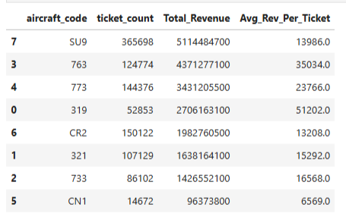

Slide 11
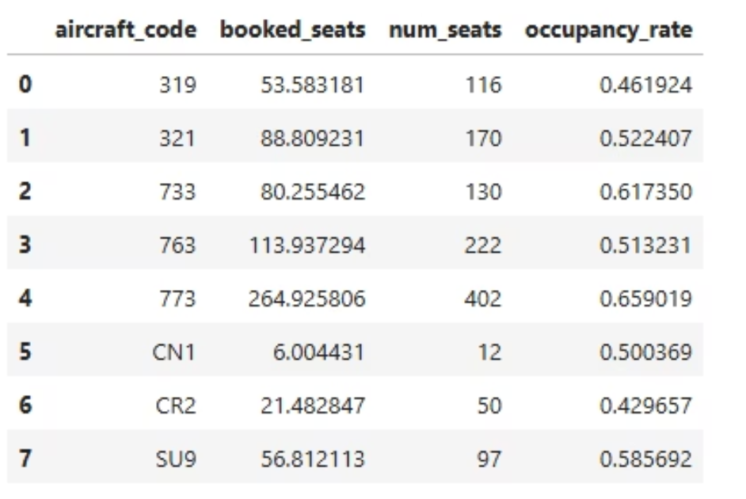
Q5) Average Occupancy Rate Per Aircraft
The average occupancy rate per aircraft is a critical performance indicator in the airline industry, directly impacting profitability and operational efficiency. It measures how effectively we are filling the seats available on each flight. Maximizing this rate is paramount for revenue optimization.
Understanding Occupancy Rate:
Definition: The occupancy rate is calculated by dividing the number of booked seats by the total number of available seats on an aircraft for a given flight. A higher percentage indicates greater seat utilization.
Revenue and Profitability Impact: Higher occupancy rates directly translate to increased revenue per flight, as more seats are sold. This also significantly boosts profitability because the fixed costs of operating a flight (fuel, crew, maintenance) are largely incurred regardless of the number of passengers.
Cost Reduction: Conversely, low occupancy rates mean more vacant seats, leading to inefficient utilization of resources and higher operational costs per passenger. Optimizing occupancy helps in lowering the operational cost associated with empty seats.
Strategic Importance:
Airlines must continuously monitor and strive to improve their occupancy rates by:
Dynamic Pricing: Implementing flexible pricing strategies that respond to demand fluctuations.
Route Optimization: Identifying and focusing on routes with consistently high demand or adjusting capacity to match demand.
Targeted Marketing: Attracting new customers through promotions and loyalty programs.
Ancillary Services: Encouraging pre-booking and offering additional services that enhance the travel experience.
The screenshot provided visually depicts the average seat occupancy for each aircraft in our fleet, highlighting how effectively each aircraft type is being utilized. This data is invaluable for strategic planning and resource allocation.

Slide 12
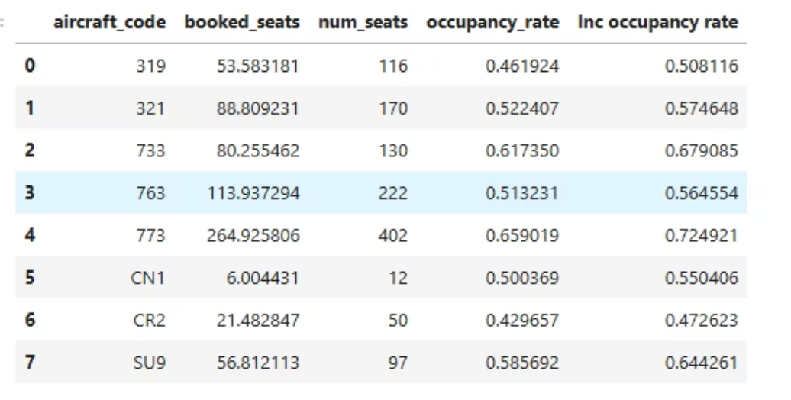
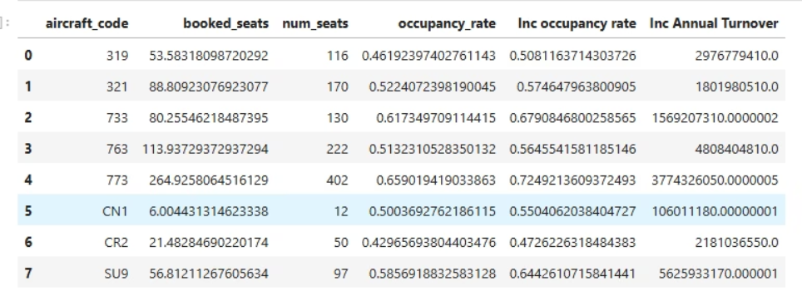
Q6) Impact of a 10% Occupancy Rate Increase on Annual Turnover
To quantify the potential financial gains from optimizing our operations, we calculated the projected increase in total annual turnover if all aircraft achieved a 10% higher occupancy rate. This hypothetical scenario underscores the immense leverage that improved seat utilization holds for our financial performance.
Key Findings and Implications:
Direct Revenue Impact: The analysis demonstrates a direct and substantial increase in yearly revenue with even a modest 10% improvement in occupancy rates across the fleet. This clearly highlights that filling a few more seats per flight can significantly amplify our financial returns, as the incremental revenue often flows directly to the bottom line with minimal additional cost.
Optimizing Pricing Tactics: The findings reinforce the critical role of pricing strategies. Dynamic pricing, fare bundling, and strategic discounting can be powerful tools to stimulate demand and incrementally boost occupancy without necessarily lowering overall yield. The goal is to find the optimal price point that maximizes both volume and revenue.
Operational Efficiency: Beyond pricing, improving occupancy rates also involves fine-tuning operational activities. This includes optimizing flight schedules to match demand peaks, ensuring timely departures to enhance customer satisfaction and loyalty, and leveraging data analytics for more precise forecasting.
Customer Value and Service: While focusing on numbers, it is crucial to remember that enhanced occupancy should not come at the expense of customer experience. Airlines can achieve higher occupancy while simultaneously delivering greater value and service by understanding passenger preferences and tailoring offerings accordingly.
The accompanying screenshots visually represent the projected financial uplift, serving as a powerful illustration of the tangible benefits associated with strategic focus on occupancy enhancement. This data strongly suggests that prioritizing initiatives aimed at improving seat utilization is a vital path to sustained profitability.

Slide 13




Key Takeaways and Next Steps
This comprehensive data analysis has illuminated critical aspects of our airline's operations and identified significant opportunities for enhancement. By focusing on the insights derived, we can strategically navigate current industry challenges and bolster our financial performance.
Data-Driven Decision Making
Fleet Optimization & Utilization
Our analysis confirmed the direct correlation between ticket bookings and revenue. We must continue to leverage data analytics for better forecasting, demand prediction, and understanding customer behavior to optimize flight schedules and resource allocation.
Identifying aircraft with higher seating capacities and understanding their revenue contribution is crucial. Focus efforts on maximizing the yield from larger aircraft and re-evaluating the efficiency of underperforming smaller aircraft like CN1.
Strategic Pricing & Revenue Management
Enhancing Occupancy Rates
The analysis of average charges by fare condition highlighted the premium value of Business Class and the consistency across the fleet. Implement dynamic pricing models and explore opportunities for introducing Comfort Class on more aircraft where demand permits, or optimize economy class yield on aircraft like CN1 and CR2.
A 10% increase in occupancy across the fleet translates to a substantial boost in annual turnover. This is our most significant leverage point. Invest in marketing campaigns, loyalty programs, and improved customer experience to attract new passengers and retain existing ones.
Recommended Next Steps:
Investigate Peak Booking Event: Conduct a deep dive into the specific factors that led to the significant peak in ticket bookings and revenue observed in the time-series analysis (Figure 1 and 2). Replicate these conditions if possible.
Market Research for CN1/CR2: Commission targeted market research for aircraft CN1 and CR2 to understand the reasons for their lower revenue despite competitive pricing. This could involve passenger surveys or competitive analysis.
Dynamic Pricing System Implementation: Explore and potentially implement more advanced dynamic pricing algorithms that can react in real-time to demand, competition, and external factors like fuel prices.
Customer Experience Enhancement: Evaluate current customer feedback channels and identify areas for service improvement that could boost loyalty and word-of-mouth referrals, contributing to higher occupancy.
Cross-Functional Team for Occupancy Growth: Establish a dedicated cross-functional team involving sales, marketing, operations, and revenue management to collaboratively develop and implement strategies to achieve the 10% occupancy rate increase target.

